Slide 1




Applied Longitudinal Data Analysis Using R.
Keith Lohse, PhD
Department of Health, Kinesiology, & Recreation
Department of Physical Therapy and Athletic Training
University of Utah

Slide 2

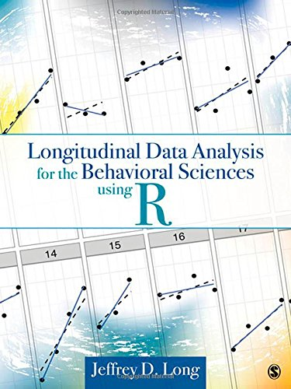
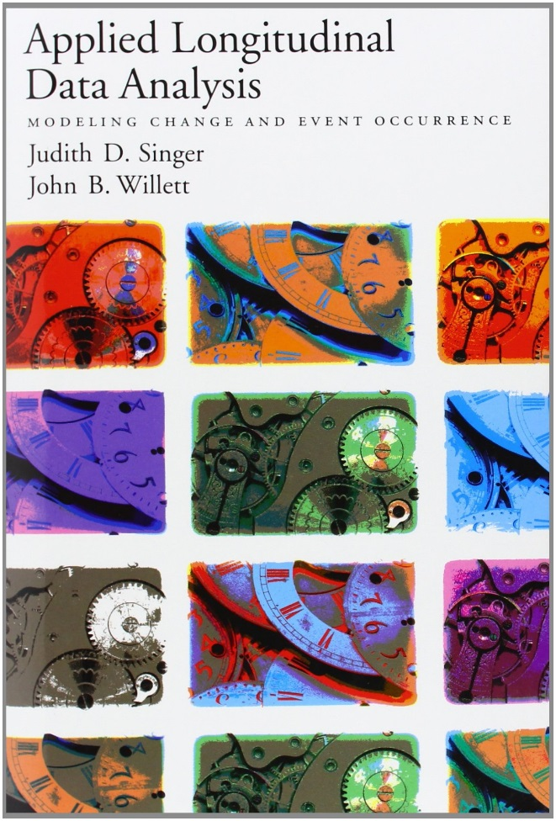


Resources:
We will be using:
R and R Studio
Packages:
lme4
ggplot
dplyr
But you can also use:
Most of what I will say has been said better in these resources!

Slide 3
Roadmap.
Opening R and Troubleshooting.
Data Visualization.
Break and questions.
Model Building
Fixed-Effects, Random-Effects, and Random-Error.
Model Comparison.
Fit statistics: AIC, BIC, and the log-likelihood test.
Break and questions.
Tips, tricks, and asking the right questions.
Phrasing your hypotheses, understanding common terms.
Preparing to meet with a statistical consultant.
Conclusions and questions.

Slide 4
Data Visualization.

Slide 5
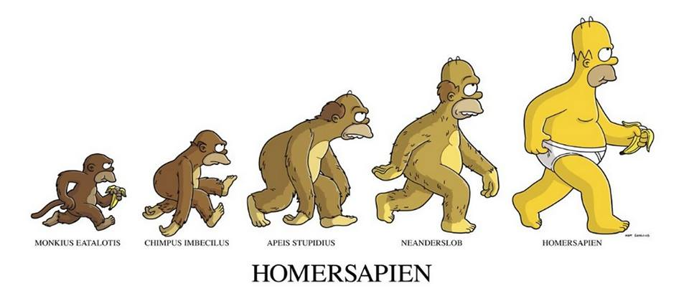
What are longitudinal data?
Multiple observations from individuals over time.
Time nested within people, people nested within classrooms, classrooms nested with schools… etc.
[Matt Groening, The Simpsons]
Observations from proximal time-points are more similar to each other than distal time points. (Auto-regressive correlation structure.)

Slide 6
Data structures.
Wide (“person”) Format:
Each person is on a row. Repeated observations in columns.
Long (“person-period”) Format
Each variable is a column. There are multiple rows for each person at each time point.
Most LMER packages require long format data.
Even SPSS (although SPSS requires the wide format for RM ANOVA).
Thus, we need organizational tools to convert between the two.

Slide 7
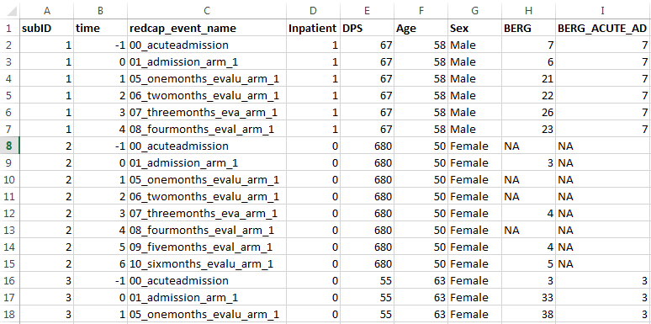
Data structures.
Sub #2 has 4/7 time points for the BERG.
In traditional RM ANOVA, we would need to remove this participant entirely!!!

Slide 8
Data structures.
Dynamic variables vary within a subject.
Static variables vary between subjects.

Slide 9
Data structures.
Repeated Measures AN(C)OVA
Linear Mixed-Effect Regression (LMER)
Participants with different numbers of observations?
Remove participants with missing cases entirely.
Not a problem.
The “within” variable is continuous?
Designed to deal with categorical “factors”.
Not a problem.
Homogeneity of regression slopes?
The coviarate must be independent of the groups.
Not a problem.
Most people are familiar with how it works?
Yes, it makes them feel comfortable and safe.
No, the statistical tools required are more recent, more complex, and currently less commonly used in many fields of research.

Slide 10
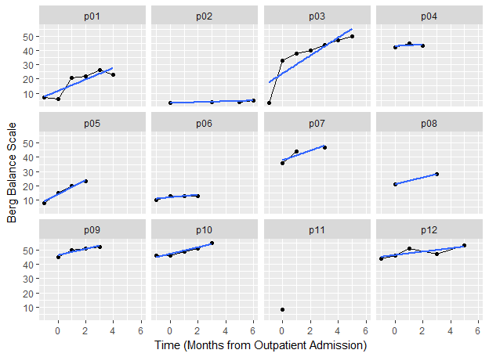
Data visualization.
How much usable data do we have for each participant?
Does the growth look linear or non-linear?

Slide 11
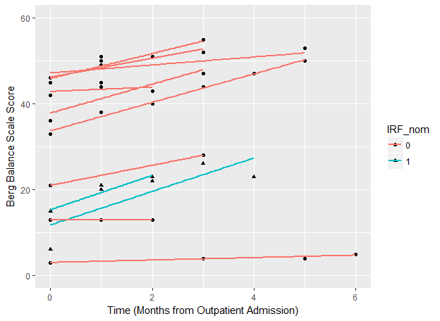
Data visualization.
We can also look at the data conditional on other factors. For instance, are there group differences between participants on average?
Are there group differences in the trajectories of our different participants?

Slide 12
Model Building

Slide 13
Understanding linear mixed-effect regression (LMER)
A generalized linear model for hierarchical linear modeling and multi-level modeling. (Raudenbush & Bryk, 2002)
Time is a predictor.
Can equally be applied to survival analysis or event history analysis. (Cox & Oakes, 1984)
Time is an outcome.

Slide 14
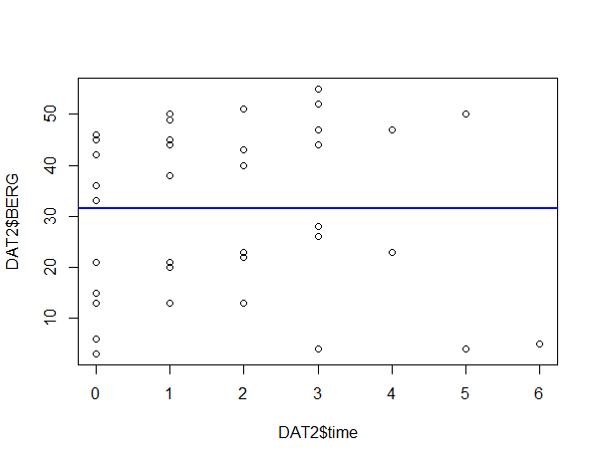

LMER versus classic Regression
Traditional Linear Model
$$y_{i}=β_{0}+β_{1}\left({Time}_{i}\right)+ε_{i}$$
The estimated slope is slightly negative, β = -0.1, and not statistically significant, p = 0.99.
This is clearly the wrong thing to do because this model ignores the fact that time points are nested within particular subjects.

Slide 15
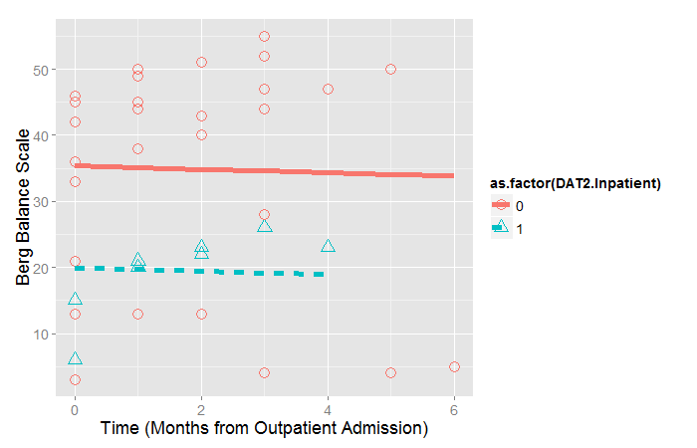

LMER versus classic Regression
Traditional Linear Model
$$y_{i}=β_{0}+β_{1}\left({Time}_{i}\right)+β_{2}({IRF}_{i})+ε_{i}$$
The estimated slope is slightly negative, β = -0.25, and people who went to IRF do worse on average, β = -15.46
This is still the wrong thing to do because this model ignores the fact that time points are nested within particular subjects, even though it accounts for variation between subjects.

Slide 16
Understanding LMER
Compressing our multi-level model to a single equation:
$y_{ij}= β_{0}+β_{1}\left({Time}_{ij}\right)+\left(u_{0i}+u_{1i}\left({Time}_{ij}\right)+ε_{ij}\right)$
Fixed Effects
Random Effects
Random Errors
For applied research, we are mostly going to be interested in the fixed-effects
What is the average rate of change?
Does initial status depend on Variable X?
But in the model building stage, we do have control over our random-effects as well.
Do we need to model different intercepts for each individual?
Do we need to model different slopes for each individual?
And we do need to worry about the relations between our random effects and between the random effects and random errors.
Are lower intercepts correlated with steeper slopes?
Are our random errors (approximately) normally distributed?

Slide 17



“Partitioning” our variance in LMER
6
Person 2
Level 1 (Participant Level)
$$y_{i}=β_{0}^{∗}+β_{1}^{∗}\left({Time}_{i}\right)+ε_{i}$$
5
4
Group Trajectory
Level 2(Group Level)
Person 1
$$β_{0j}^{∗}=β_{0}+u_{0j}$$
Clinical Assessment (Score)
3
$$β_{1j}^{∗}=β_{1}+u_{1j}$$
2
Individual variation
1
0
0
2
4
6
8
10
12
Time in Outpatient Therapy (months)

Slide 18



“Partitioning” our variance in LMER
Did not go to IRF
(lower initial severity)
Level 1 (Participant Level)
6
$$y_{i}=β_{0}^{∗}+β_{1}^{∗}\left({Time}_{i}\right)+ε_{i}$$
5
Level 2(Group Level)
4
$$β_{0j}^{∗}=β_{0}+β_{2}\left({IRF}_{i}\right)+u_{0j}$$
Clinical Assessment (Score)
$$β_{1j}^{∗}=β_{1}+{β_{3}\left({IRF}_{i}\right)+u}_{1j}$$
3
2
Fixed-Effects:
1. Average intercept/slope
2. Effect of ‘X’ on intercept/slope
1
Went to IRF
(higher initial severity)
0
Random-Effects:
3. Participant deviations from group intercept/slope (mean and variance).
4. Correlation between deviations.
0
2
4
6
8
10
12
Time in Outpatient Therapy (months)

Slide 19
Two default models that we will use a lot.
The Random Intercepts model.
Estimate a constant (flat line) for each participant.
The Random Slopes model.
Estimate a trajectory (sloped line) for each participant.
These are the “starter” models that we will use in most of our model building.
Essentially the Random Slopes model is the “model to beat” in evaluating our subsequent fixed-effects.

Slide 20
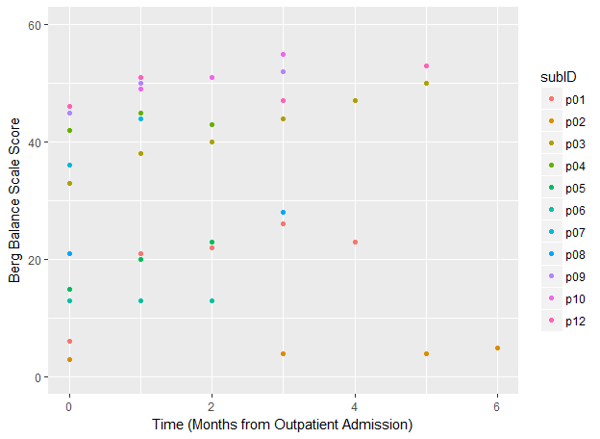



Random Intercepts Models
Overall Model:
$$y_{ij}=β_{0}+u_{0j}+ε_{ij}$$
Level 1 (Participant Level):
$$y_{i}=β_{0}^{∗}+ε_{i}$$
Level 2 (Group Level):
$$β_{0j}^{∗}=β_{0}+u_{0j}$$

Slide 21
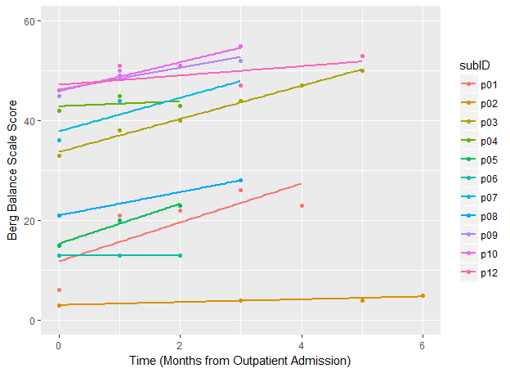



Random Slopes Model
Overall Model:
$$y_{ij}=β_{0}+u_{0j}+ε_{ij}$$
Level 1 (Participant Level):
$$y_{i}=β_{0}^{∗}+β_{1}^{∗}\left({Time}_{i}\right)+ε_{i}$$
Level 2 (Group Level):
$$β_{0j}^{∗}=β_{0}+u_{0j}$$
$$β_{1j}^{∗}=β_{1}+u_{1j}$$

Slide 22
Model Comparisons

Slide 23
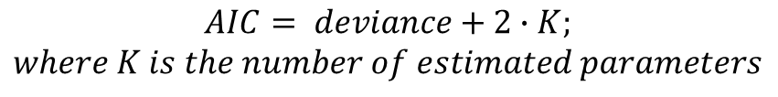
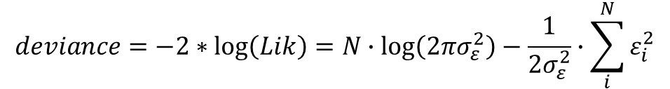
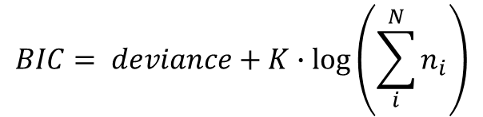
How to decide which model is the best explanation of the data?
$$deviance=−2∗\log\left(Lik\right)=N∙\log\left(2πσ_{ε}^{2}\right)−\frac{1}{2σ_{ε}^{2}}∙\sum_{i}^{N}{ε_{i}^{2}}$$
Deviance
Larger sample size means bigger deviance.
Larger error means bigger deviance.
Thus, for a constant sample size, smaller deviance means better fit.
Akaike Information Criterion (AIC)
Bayesian Information Criterion (BIC)
$$AIC= deviance+2∙K;$$
$$where K is the number of estimated parameters$$
$$BIC= deviance+K∙\log\left(\sum_{i}^{N}{n_{i}}\right)$$

Slide 24
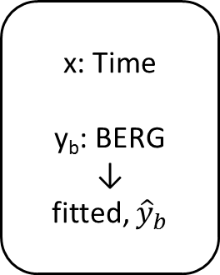
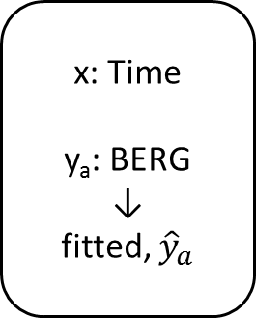

The AIC: The best measure of “predictive” deviance.
Population of Interest
Sample A
Sample B
Sample C
x: Time
y_{a}: BERG
↓
fitted, ${\hat{y}}_{a}$
x: Time
y_{b}: BERG
↓
fitted, ${\hat{y}}_{b}$
x: Time
y_{c}: BERG
↓
fitted, ${\hat{y}}_{c}$
deviance
Predictive
deviance
[Long, 2012]

Slide 25
The AIC: The best measure of “predictive” deviance.
For a given sample, the most complex model is always going to lead to the smallest deviance.
More complex models explain more error even by chance.
The AIC imposes a penalty for additional parameters and the AIC is an unbiased estimate of the long run predictive deviation.
That is, your model with smallest AIC is most likely to be the model with the smallest AIC for a different researcher testing a different sample from the same population.

Slide 26
The model comparison approach.
Are all models based on the same amount of data?
Deviance increases with additional observations. Data pools must be the same size.
How many parameters are being tested?
We want to avoid “over-fitting”, so it is good to look for the model with the lowest AIC/BIC.
How big is the sample size?
The BIC can be overly conservative with large sample sizes.
I would recommend the AIC as it is an unbiased estimate of the predictive deviance.

Slide 27
Tips, tricks, and asking the right questions.

Slide 28
TBD

Slide 29
Thank you very much!
If you have any questions regarding this talk or the LMER code in the accompanying script file, please email me:
rehabinformatics@gmail.com

